Slide 1
Team Project 1
Purple Team, presenting on Part II
Raza Lamb, Robert Wan, Erika Fox, Minjung Lee, Preet Khowaja

Slide 2
Introduction
This is an analysis to infer the relationship between job training for disadvantaged workers and their wages, from an experiment conducted at the National Supported Work (NSW) Demonstration.
Question of Interest:
Is there evidence that workers who receive job training tend to be more likely to have positive (non-zero) wages than workers who do not receive job training?
More specifically:
Quantify the effect of the treatment, that is, receiving job training, on the odds of having non-zero wages.
What is a likely range for the effect of training?
Is there any evidence that the effects differ by demographic groups?
Are there other interesting associations with positive wages that are worth mentioning?

Slide 3
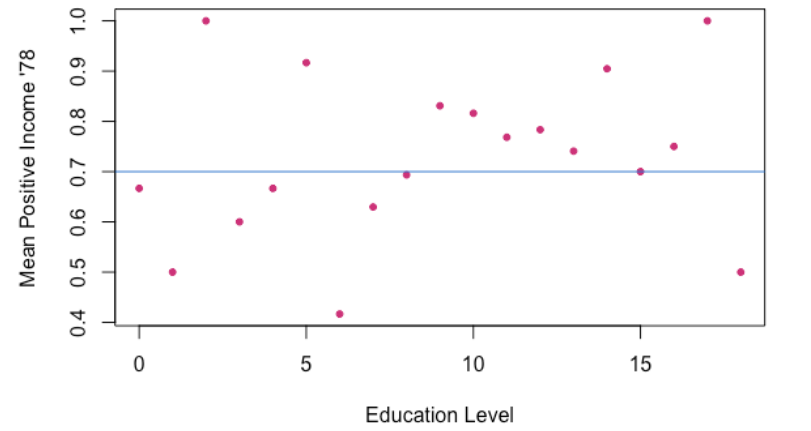
Data
We decided to use re74 as the baseline income variable. We did not use the variable re75. While the control group was selected based on income in 1975, the income for the treatment group is not comparable as some people began their training in 1975.
We created additional factor variables based on insights from the EDA:
positive: 1 if the participant had a positive (non-zero) income in 1978, 0 otherwise. (the response variable)
zero: 1 if the participant had a non-positive income (income of 0) in 1974, 0 otherwise.
newed: 1 if educ is greater than or equal to 9 years of education, 0 otherwise.

Slide 4
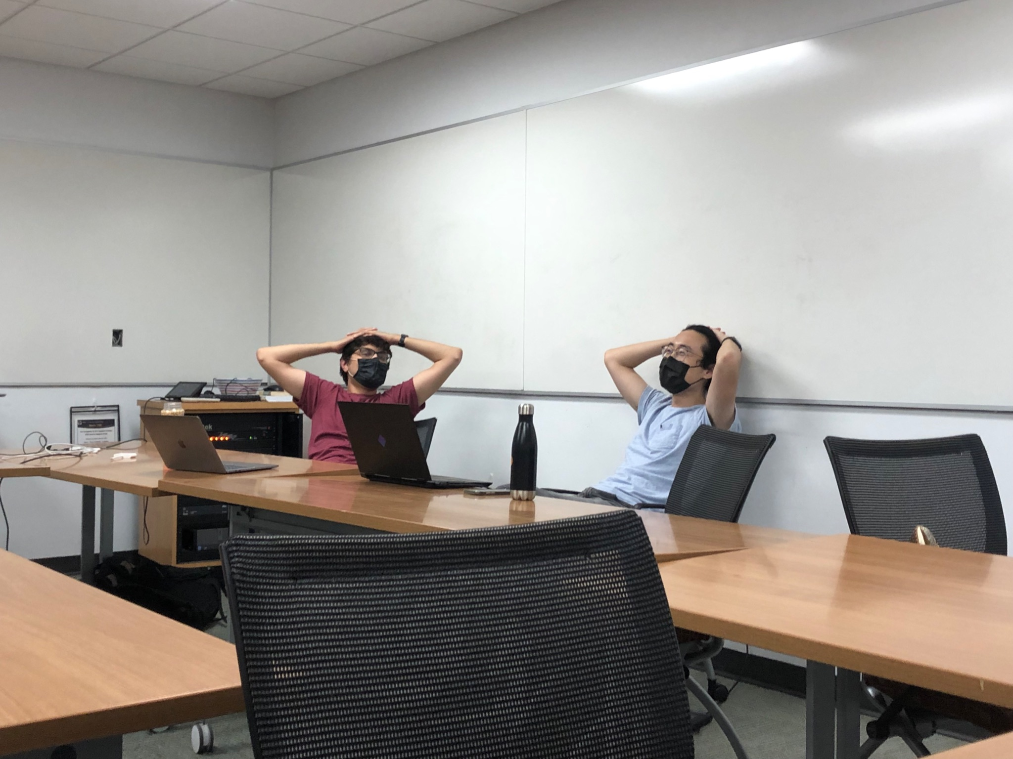
Data
“If you have any pretty pictures..”

Slide 5

Model, part 1: Selection
Selection methods: aic_backwards, aic_stepwise, and bic_stepwise
Null Model predictors: treat
Full Model predictors: treat:agec, treat:educc, treat:black, treat:hispan, treat:married, treat:re74c, treat:zero, treat:newed, black:re74c , re74c:married, educc:black, and educc:married

Slide 6
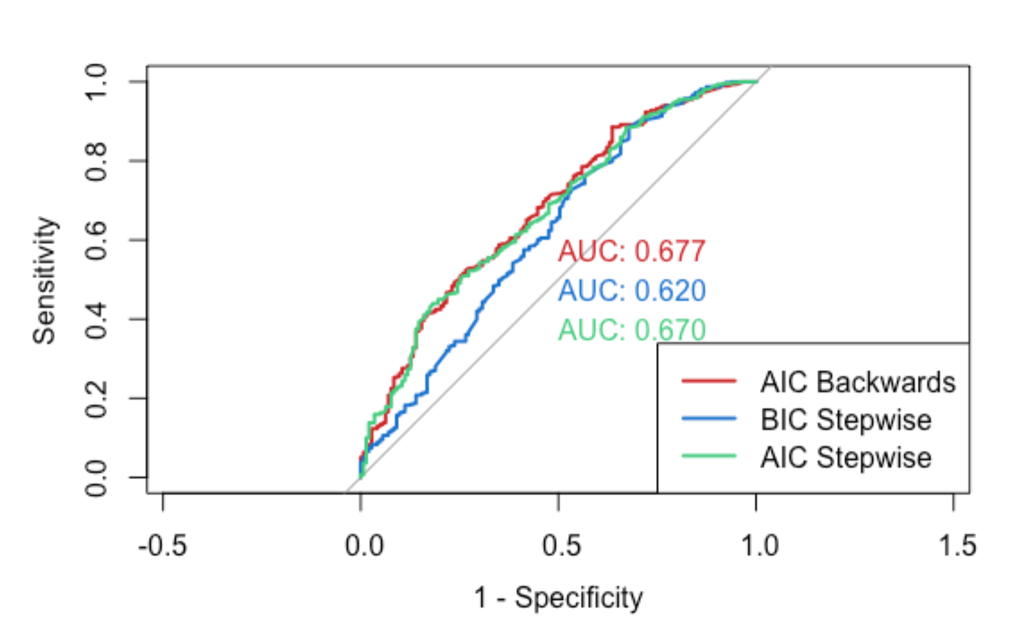

Selection Results
AIC_Backwards vs AIC_Stepwise
AIC_Backwards: the interaction of treat:zero is included and significant
AIC_Stepwise: treat is significant in AIC_Stepwise, while it is not in AIC_Backwards
We used Chi-squared tests to determine which model to use because the ROC curves are similar
The test for BIC_Stepwise and AIC_Backwards revealed that the difference between them is significant enough for us to use AIC
The difference between AIC_Backwards and AIC_Stepwise was not significant

Slide 7
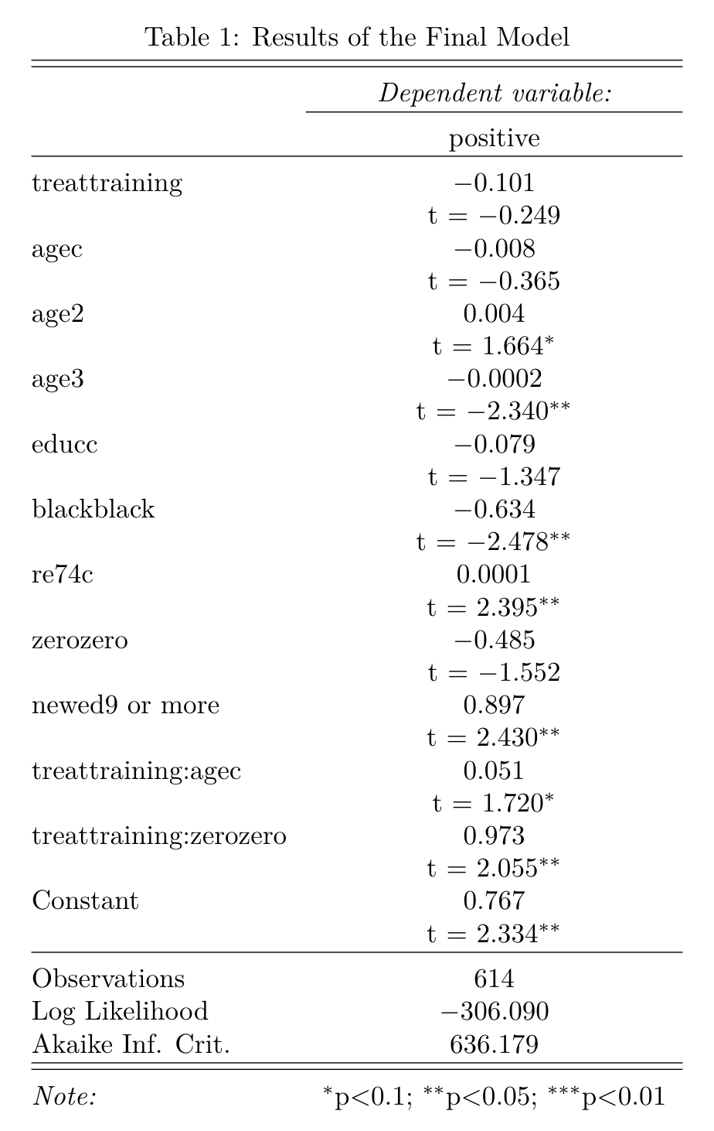
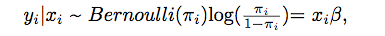
AIC backwards results:
However, during model assessment, we found a trend. So we added some transformations for our final model. We also removed two terms.
Final model:
where 𝘺_{i} is positive. 𝘹_{i} includes the predictors variables: treat, agec, educc, black, re74c, zero, hispanic, and newed, and the interactions treat:agec, treat:hispanic, and treat:zero. 𝜷 is a vector representing the predictor coefficients.
same as model above with added agec² and agec³ terms and removed hispanic and treat:hispanic terms

Slide 8
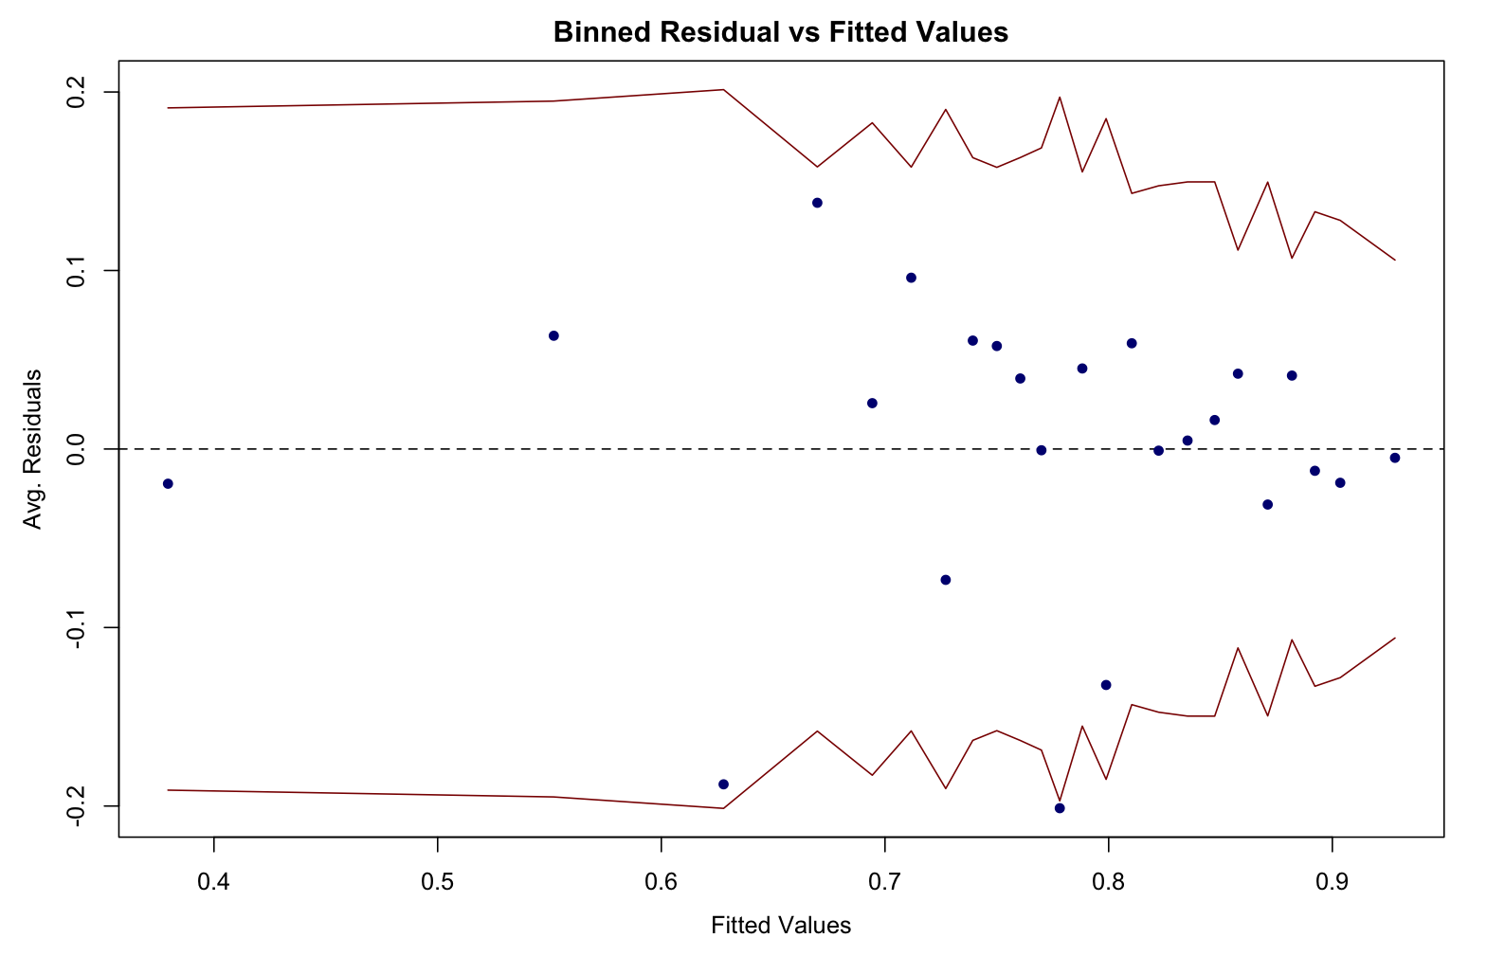
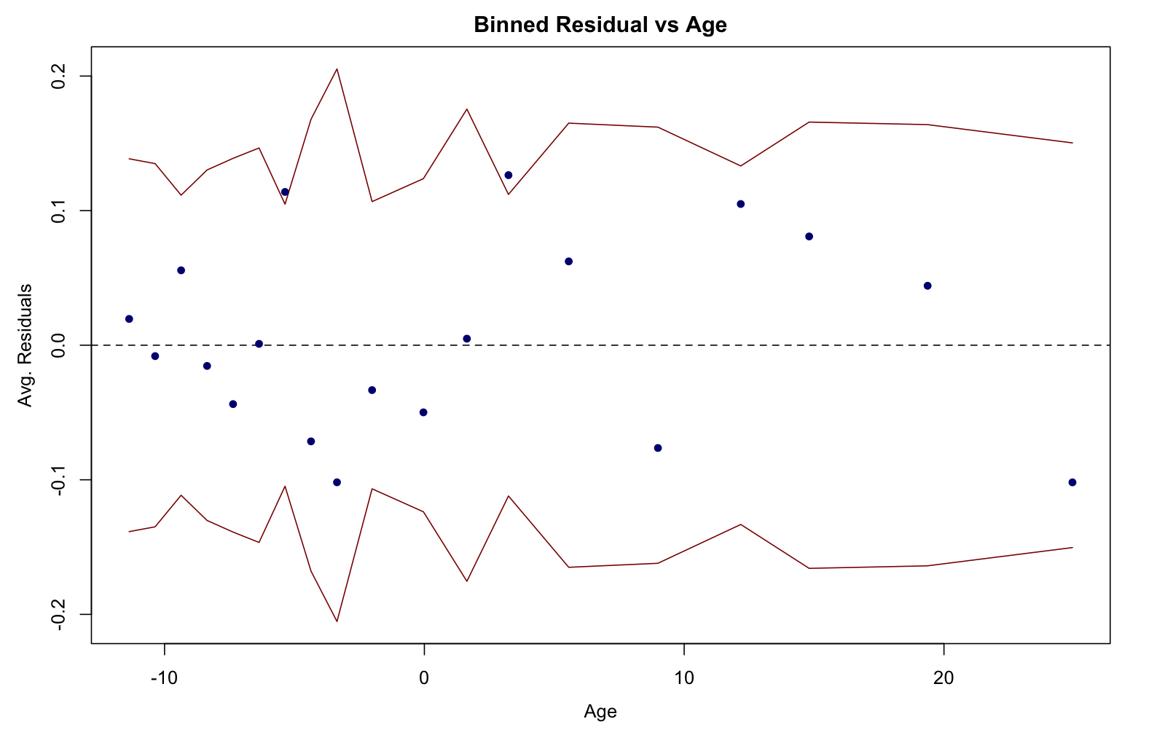
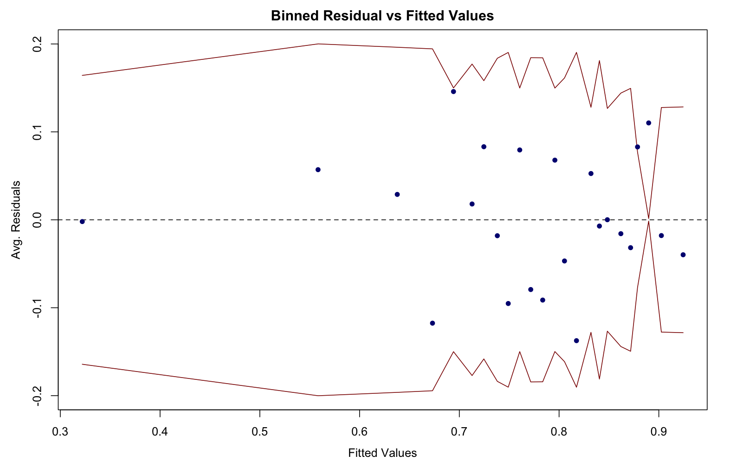
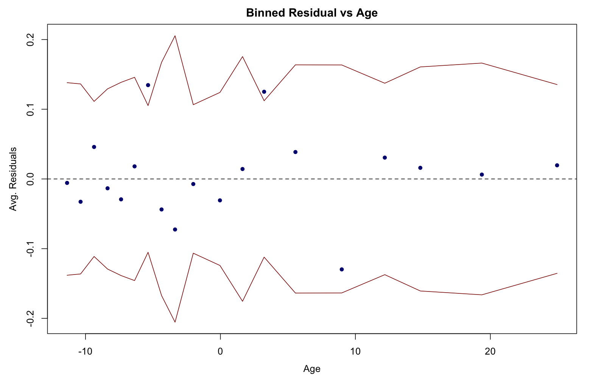
Model, part 2: Assessment
Before transformation:
After
transformation:

Slide 9
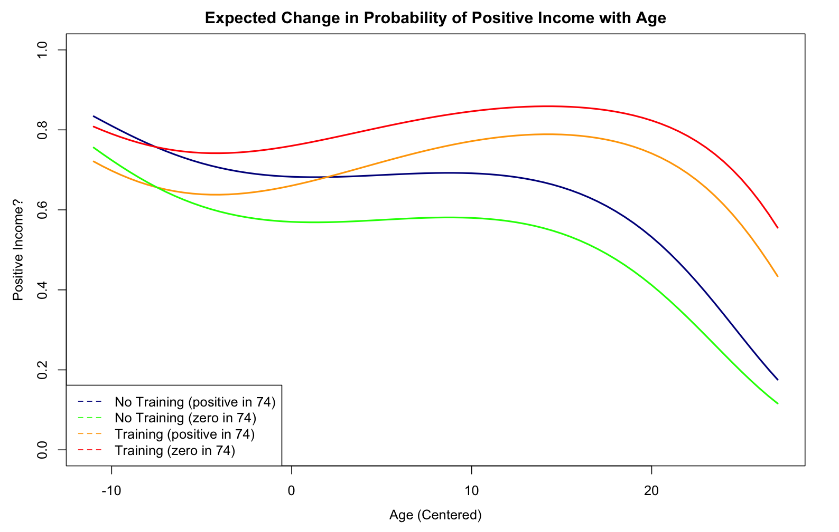
Interpretation and Conclusions
Limitations:
Unable to use re75 variable in our analysis, because of noise
This interpretation is specific to the training program represented in this data.
The control group might not have the same characteristics as the test group, because we selected them using different methods.
Some categories were lacking in data (i.e. hispanic), prompting us to exclude the variable from our model.
Modern inference about job training from this analysis is inappropriate as this data is from the 70’s, only includes men, etc.

Slide 10




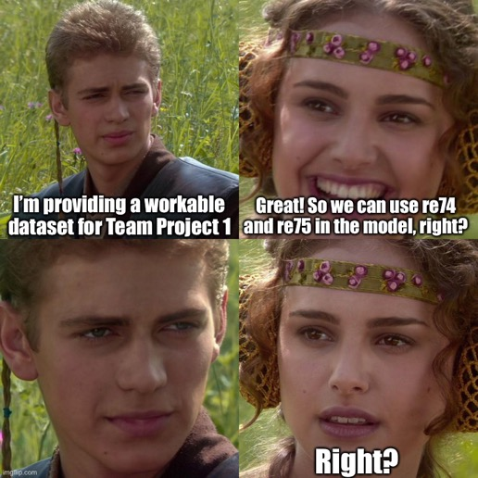

A gallery of 702 memes
Moritz
Robert
Satvik
Robert
Raza
Preet

